Slide 1

Student Problem Solving System
- An Integrated Student Platform
Bhargav Pitta(N190106)

Slide 2
Table of Contents
Abstract
Introduction
Related Works
Web Pages and Technologies
5. Django
6. Future Scope
7. Conclusion

Slide 3
Abstract
The Student Study Portal is designed to provide students with an integrated platform that combines various study tools.
The portal includes features such as Notepad, To-Do List, Dictionary, Wikipedia access, YouTube Recommendations, Book Recommendations, and Book Conversion.
The frontend is built using HTML, CSS, and JavaScript, while the backend is managed with Django.
This project aims to enhance the efficiency and effectiveness of students' study routines by offering a centralized hub for their academic needs.

Slide 4
Introduction
The Student Study Portal was developed to address the need for a unified platform where students can access multiple study tools in one place.
The portal provides an easy-to-use interface where students can take notes, manage tasks, look up definitions, access Wikipedia articles, receive YouTube recommendations, get book suggestions, and convert book formats.
By combining these features, the portal aims to simplify and streamline the study process, making it more productive and enjoyable for students.

Slide 5
Related works
Several platforms offer individual tools similar to those in our portal, such as Evernote for note-taking, Google Tasks for to-do lists, and various dictionary apps.
However, our portal differentiates itself by integrating all these tools into a single interface, reducing the need to switch between multiple apps.
Unlike other platforms, our portal also includes unique features like YouTube educational recommendations and book format conversion, which are not commonly found together in a single application.

Slide 6



Student Study Portal
Register
Create an account to access the full suite of features on the student study portal.
Login
After registering, log in to the portal to begin exploring the resources
and tools available.
Explore
Dive into the portal's extensive library, track your progress, and get personalized feedback to support your academic journey.

Slide 7
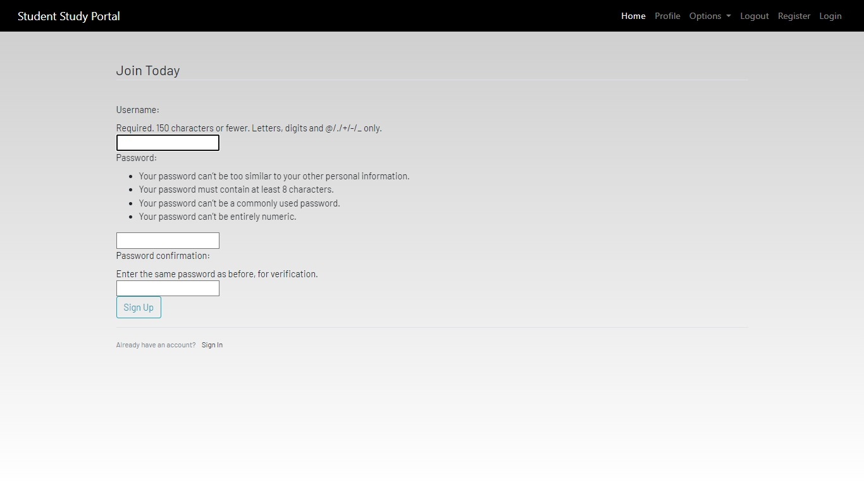
Register here to join our community and access exclusive student resources

Slide 8
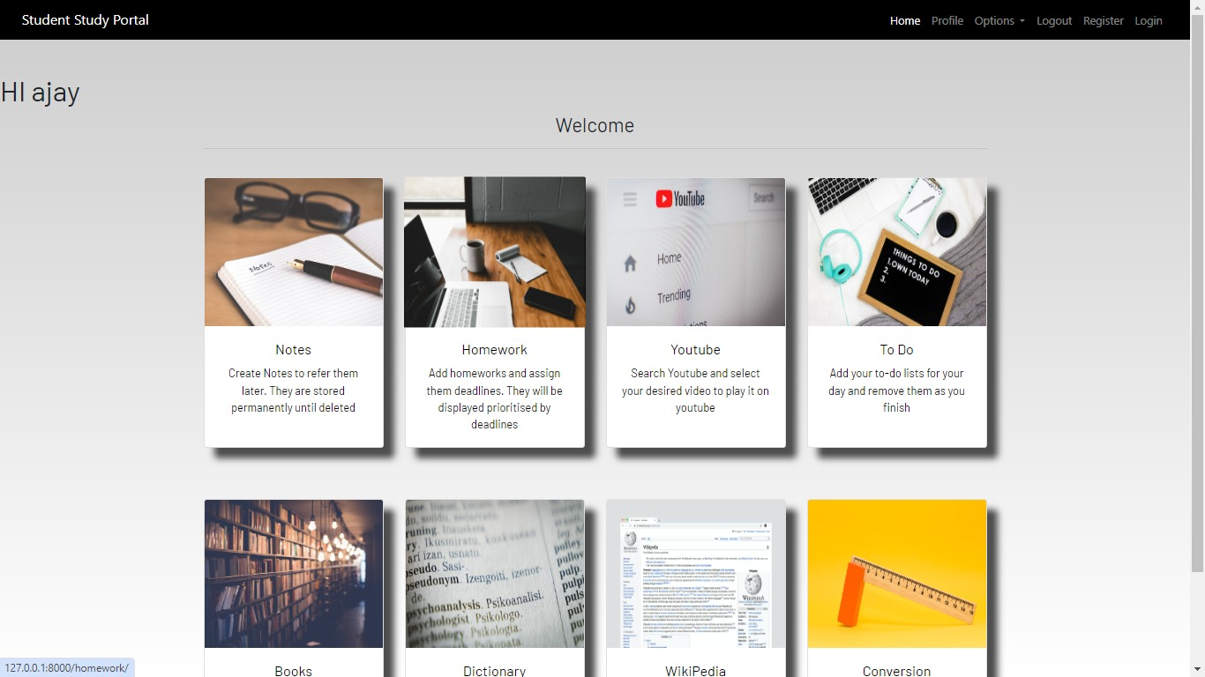
Homepage
The homepage of the student study portal is a user-friendly dashboard that helps students manage all their study needs in one place.The homepage is designed to be clean and straightforward, ensuring that students can find and use all the tools they need with ease. By centralizing all these resources, the study portal helps students stay organized, manage their time better, and enhance their learning experience.where this homepage
Consist of notes,homework,youtube,to do,books,dictionary,wikipedia, conversion,.

Slide 9
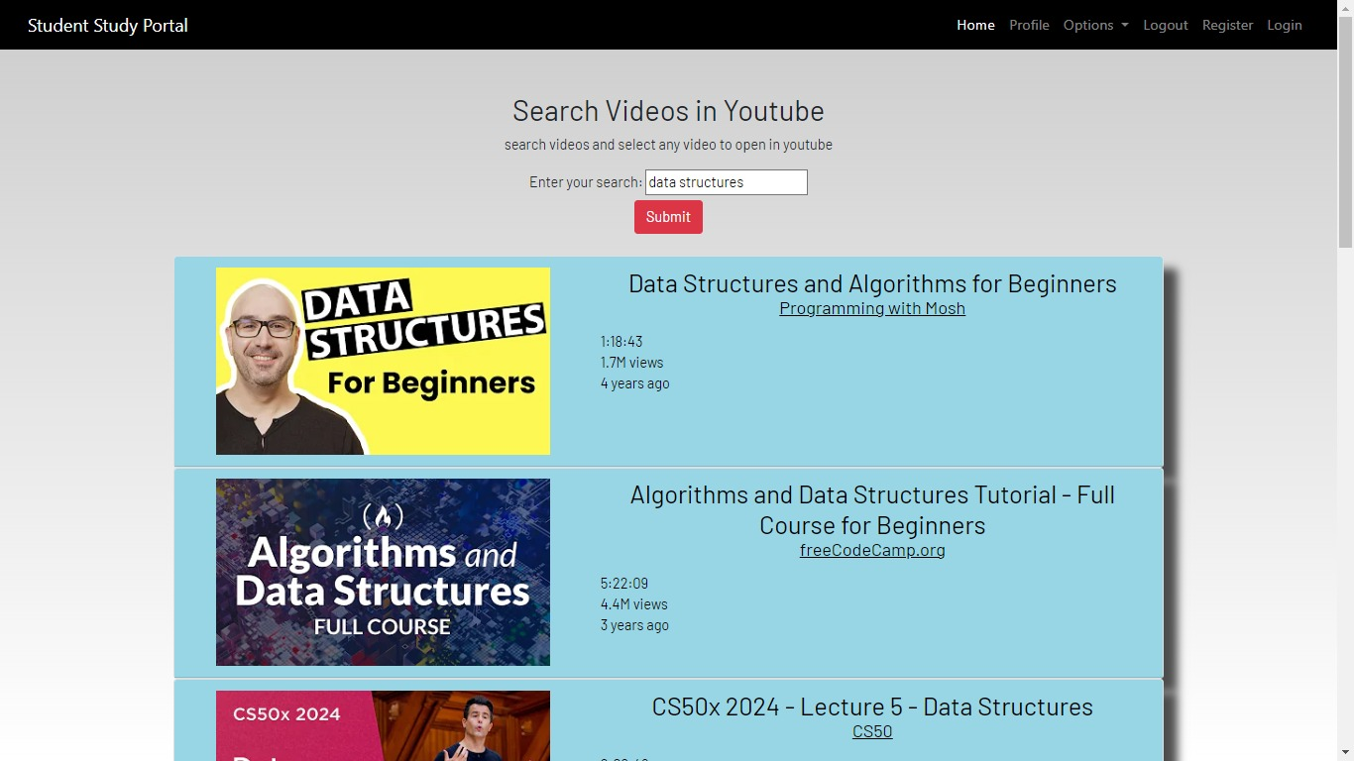
YouTube Recommendations: Offers personalized educational video recommendations.

Slide 10
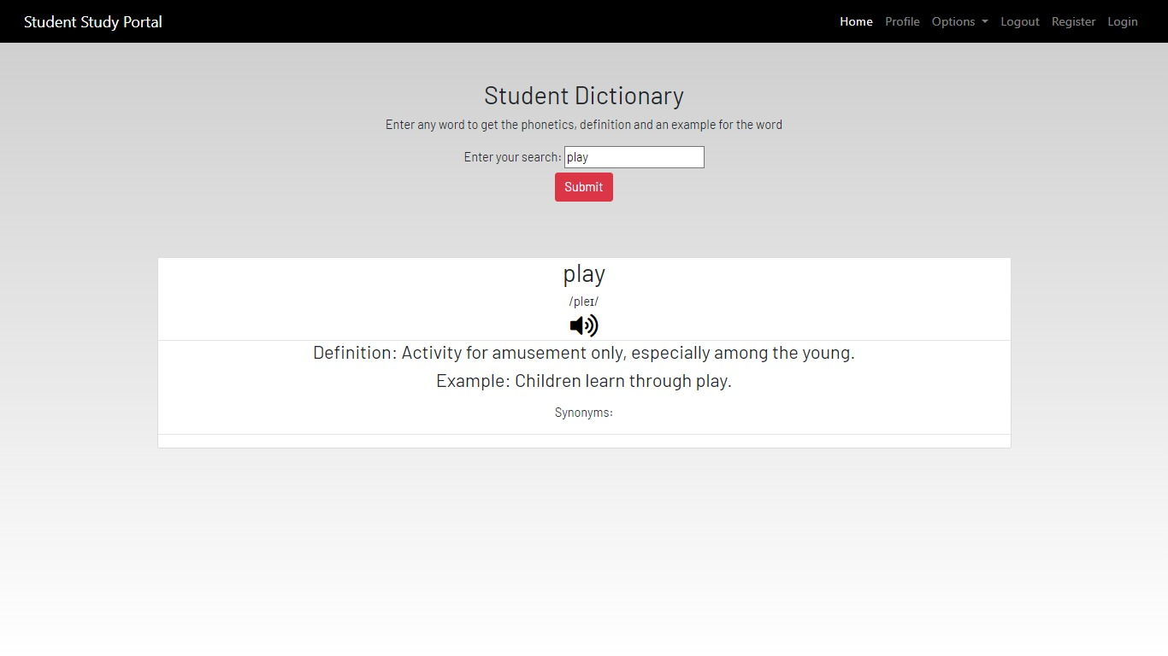
Dictionary: Provides word definitions and synonyms

Slide 11
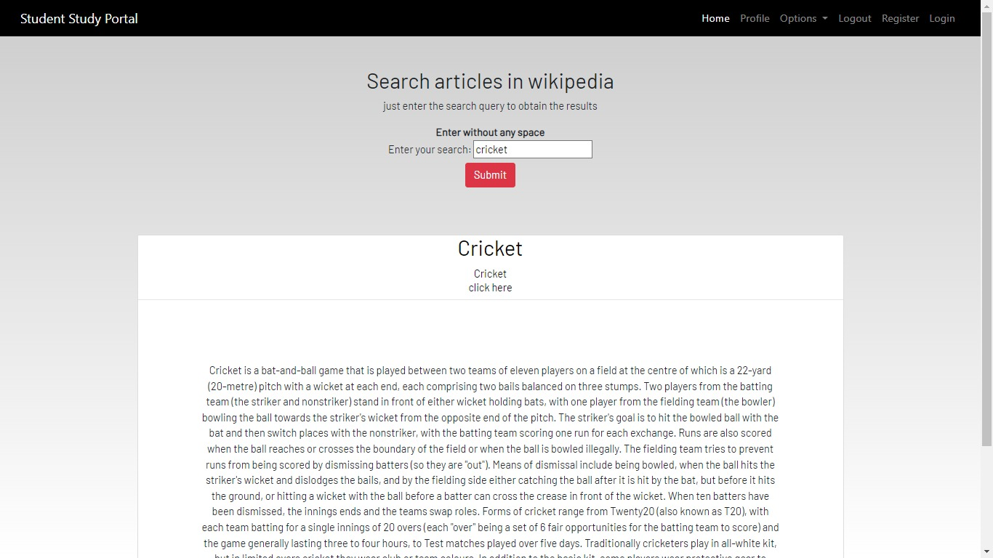
Wikipedia: Enables direct access to Wikipedia searches within the portal

Slide 12
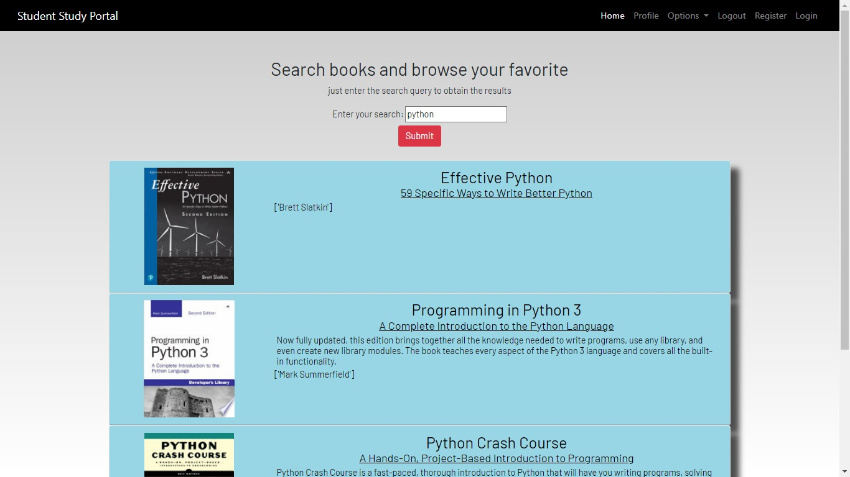
Book Recommendations: Suggests books based on user preferences and reading history

Slide 13
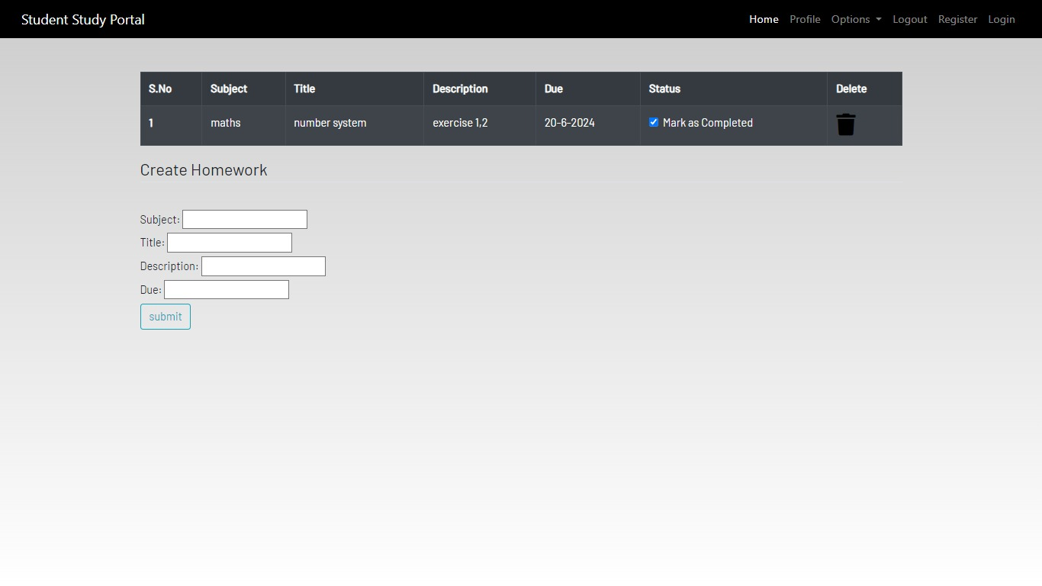
Homework: Helps users create and manage their tasks with ease

Slide 14
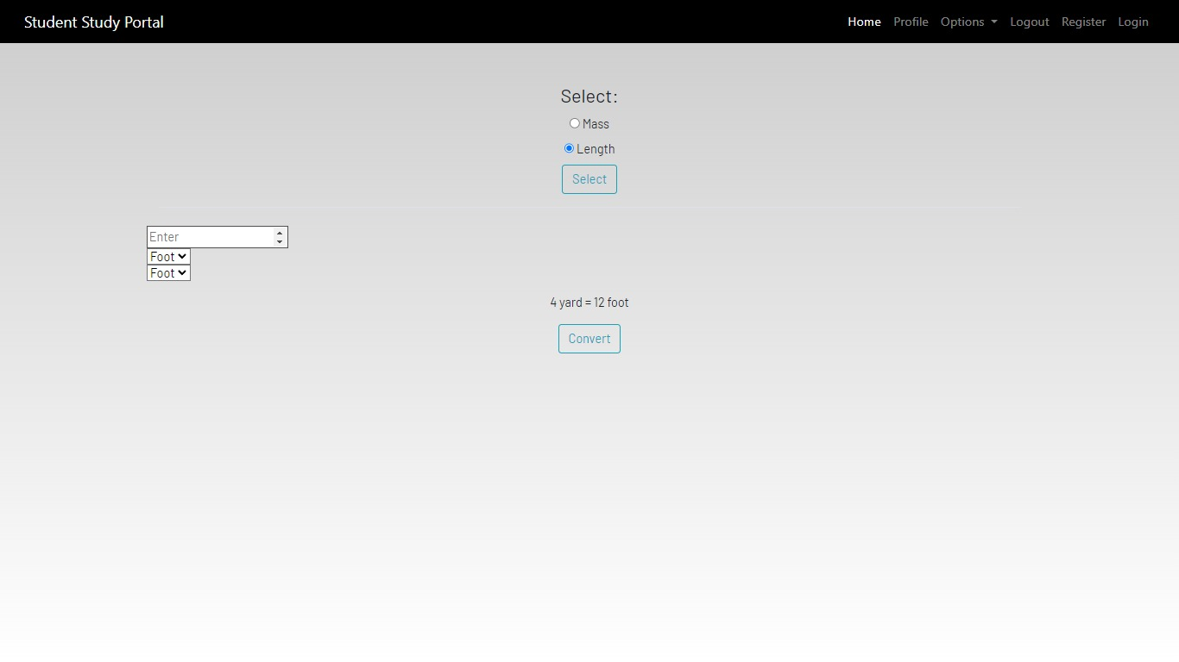
Conversion: Converts into different formats (e.g., Length to yard).

Slide 15
HTML (HyperText Markup Language)
HTML is the standard language for creating web pages. It describes the structure of a web page using markup.
HTML elements are the building blocks of HTML pages. These elements are represented by tags, such as <div>, <h1>, <p>, <a>, etc.
CSS (Cascading Style Sheets)
CSS is used to control the presentation of HTML elements, including layout, colors, fonts, and spacing.
CSS allows you to create visually engaging web pages and ensures a consistent look across multiple pages.
JavaScript
JavaScript is a versatile programming language used to add interactivity and dynamic behavior to web pages.
It allows you to create responsive elements that respond to user actions, such as clicks, inputs, and other events.

Slide 16
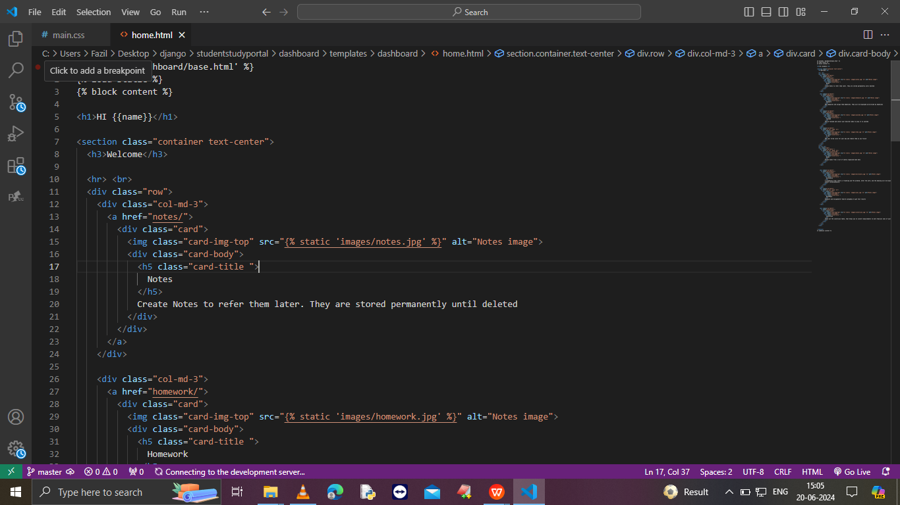

Slide 17
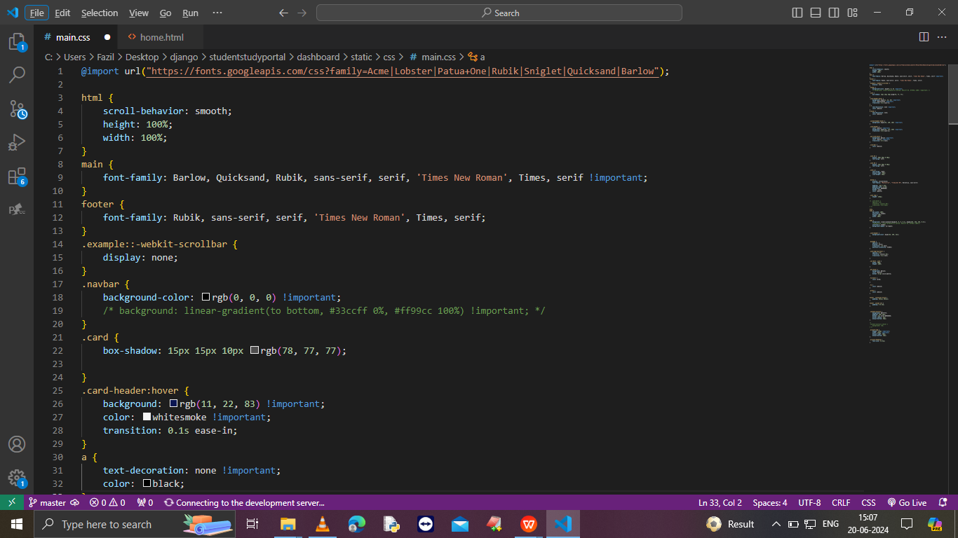

Slide 18
Django:
Django is a high-level Python web framework designed for rapid development and clean, pragmatic design.
It simplifies the creation of complex, database-driven websites by providing reusable components and a robust architecture.
Key Features of Django
MTV Architecture:
Model: Defines the data structure and handles database interactions using Django's ORM.
View: Processes user requests, interacts with the model, and returns appropriate responses.
Template: Renders HTML based on the data provided by the views.

Slide 19
Built-in Admin Interface:
Provides a powerful, ready-to-use interface for managing application data.
Greatly reduces the amount of code needed to manage the application.
Security:
Protects against common web vulnerabilities such as SQL injection, cross-site scripting (XSS), cross-site request forgery (CSRF), and clickjacking.
Includes tools for managing user authentication and permissions.
Reusability:
Encourages the use of reusable components, making it easier to maintain and expand the application.
Supports the development of reusable apps that can be plugged into other Django projects.

Slide 20
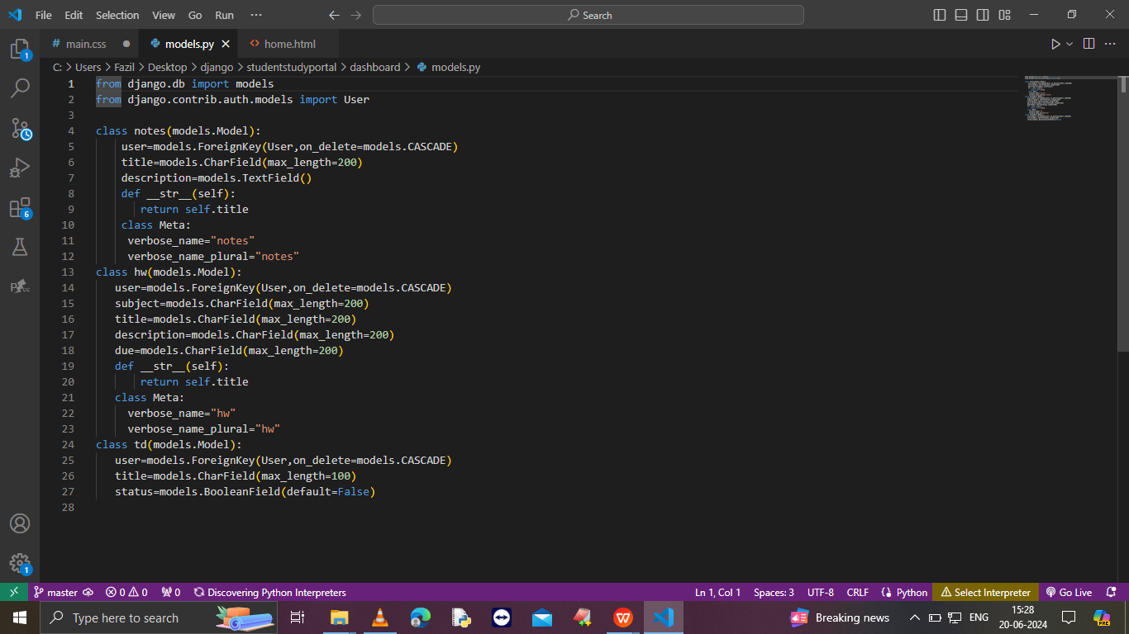
Django:model.py

Slide 21
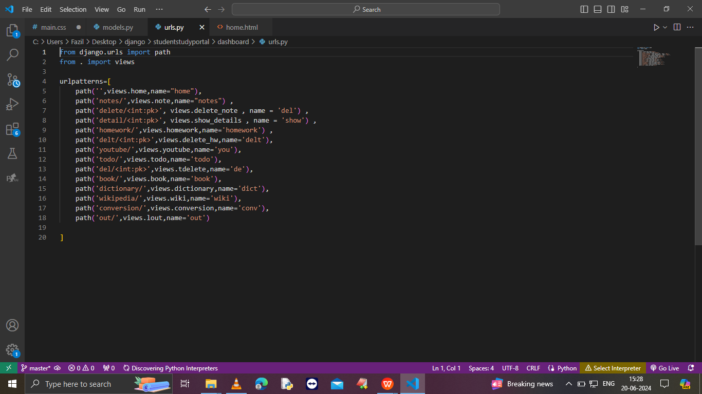
Django:url.py

Slide 22
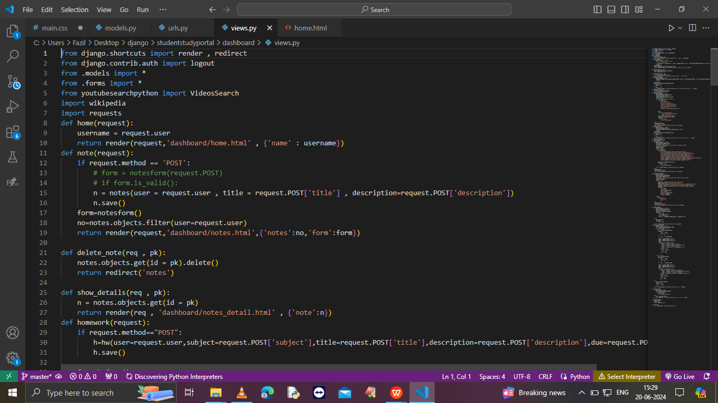
Django:views.py

Slide 23
Future scope:
Enhanced Personalization:
Use machine learning to recommend personalized study materials and resources based on student behavior and preferences
App Development :
Develop a mobile application for easier access and study on-the-go.
Advanced Analytics:
Provide detailed analytics and reports to track student progress and performance.
.Integration with Other Platforms:
Integrate with popular educational platforms like Coursera, Khan Academy, or online libraries for a wider range of resources.
Gamification:
Introduce gamification elements like badges, leaderboards, and rewards to make studying more engaging.
Offline Access:
Allow students to download resources and tools for offline use, ensuring they can study without an internet connection.

Slide 24
Conclusion:
The Student Study Portal successfully integrates multiple study tools into one easy-to-use platform. It simplifies the study process by providing centralized access to essential tools like Notepad, To-Do List, Dictionary, and more. The project demonstrates effective use of HTML, CSS, JavaScript, and Django to create a cohesive and functional application.

Slide 25
THANK YOU

